Slide 1

(Accredited By National Assessment & Accreditation Council (NAAC))
(Approved by AICTE, New Delhi & Affiliated to Visvesvaraya Technological University, Belagavi)
Doddaballapura Main Road, Avalahalli, Yelahanka, Bengaluru-560119.
REAL TIME AI/ML QUISHING AND SMISHING DETECTION AND PREVENTION SYSTEM
NITHIN NAIK.R(1BY23CS152) UMAR(1BY23CS190) SAGAR S.H(1BY24CS415) PRASHANTH(1BY23CS161)
B.E.
COMPUTER SCIENCE AND ENGINEERING
UNDER THE GUIDANCE OF:
Prof. BRUNDA S
Assistant Professor
DEPT. OF CSE
BMSIT&M
2026-27

Slide 2
CONTENT
Abstract
Introduction
Problem statement
Objectives of the work
Proposed Methodology
Flow Diagram
SDG mapped (as per the metrics provided by Dept.)
Project management and Finance
References(IEEE format)

Slide 3
ABSTRACT
The rapid growth of mobile banking, QR-based payments, and SMS communication has led to an increase in phishing attacks targeting mobile users. QR phishing (quishing) and SMS phishing (smishing) exploit user trust by embedding malicious links in QR codes and deceptive text messages, making detection difficult, especially in zero-day scenarios. Traditional detection systems rely on blacklist databases and external APIs, which are ineffective against newly generated phishing domains and dynamically crafted messages. This project proposes a self-contained Unified Zero-Day Phishing Detection System that operates without external APIs, ensuring privacy and offline capability. The system uses Natural Language Processing techniques, including TF-IDF and Logistic Regression, to classify SMS content, along with URL feature extraction methods such as entropy analysis, special character frequency, homograph detection, and HTTPS validation. An Isolation Forest–based anomaly detection model is incorporated to identify previously unseen threats. Experimental evaluation demonstrates improved detection of novel phishing samples, reduced false negatives, and explainable risk scoring, enhancing resilience against zero-day QR and SMS phishing attacks.
Key words:
Zero-Day Detection, QR Phishing, SMS Phishing, Machine Learning, NLP, Isolation Forest, Feature Engineering, Explainable AI, Cybersecurity, Offline Detection

Slide 4
INTRODUCTION
Phishing attacks have evolved into highly sophisticated cyber threats exploiting human psychology, weak security configurations, and gaps in legacy detection mechanisms.
Threat actors now leverage Machine learning (ML), Deep learning (DL), and natural language generation (NLG) to create context-aware phishing campaigns that bypass signature- and rule-based security systems.
Attack vectors are no longer limited to email; they now span SMS, instant messaging platforms, and websites using domain spoofing, homoglyph attacks, and redirection chains.
The dynamic and polymorphic nature of these attacks has rendered traditional anti-phishing mechanisms such as static URL blacklists, regex-based filters, and signature matching ineffective against zero-day exploits.

Slide 5
PROBLEM STATEMENT
In today’s digital world, mobile users depend heavily on QR codes and SMS messages for banking and payments, making them vulnerable to phishing attacks. QR phishing and SMS phishing exploit user trust by delivering malicious links that often bypass traditional security systems.
Most existing solutions rely on blacklists and external APIs, which fail to detect newly generated (zero-day) phishing attacks and raise concerns related to privacy and delayed response. As attackers continuously create new domains and deceptive message patterns, users remain exposed to financial loss and data theft. Therefore, there is a need for a self-contained, intelligent detection system that can proactively identify suspicious patterns and protect users against emerging QR and SMS-based phishing threats without relying on external services.

Slide 6
OBJECTIVES OF THE WORK
To continuously monitor incoming SMS messages and scanned or embedded QR codes in real time.
To preprocess SMS text and QR code images using NLP techniques and computer vision methods for reliable feature extraction.
To analyze SMS content using AI/ML models (TinyBERT / CNN-GRU) for detecting smishing attacks based on context, urgency, and sender patterns.
To detect malicious QR codes using CNN-based visual analysis and URL safety classification models.
To correlate SMS content with QR-decoded URLs to identify contextual phishing attacks and brand impersonation attempts.
To develop a real-time AI/ML-based phishing detection and prevention system for malicious links and QR codes used in digital and UPI transactions and Threat SMS.

Slide 7
METHODOLOGY
Data Acquisition Layer:
*Dual-Input Streams: Simultaneous monitoring of incoming SMS text and embedded/scanned QR code images.
*Feature Extraction: Utilizing NLP for text metadata and Computer Vision for QR payload extraction.
The AI/ML Core (Hybrid Pipeline):
*Smishing Module: Employs TinyBERT or Hybrid CNN-GRU to analyze text context, urgency, and sender reputation.
*Quishing Module: Uses CNN-based classification (ResNet/VGG) to detect "visual" tampering and XGBoost to evaluate the decoded URL safety.
Cross-Verification Engine:
Correlates SMS context with QR landing pages to detect "Contextual Phishing" (e.g., an SMS about banking leading to a non-banking URL).
Actionable Prevention Layer:
*Real-Time Risk Scoring: Categorizes threats as Low, Medium, or High.
*Automated Response: Instant blocking of malicious links and user alerts with visual safety indicators.

Slide 8
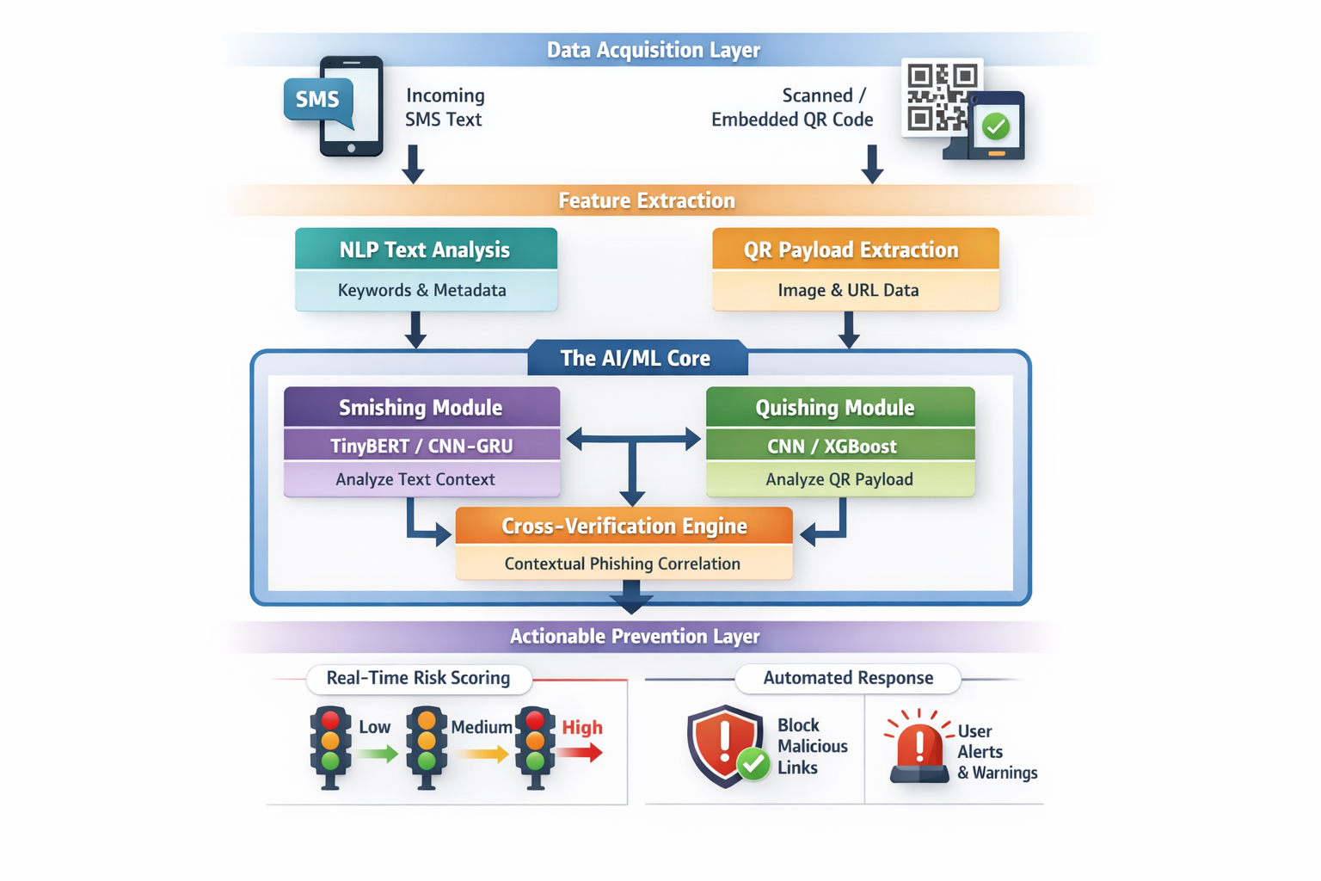
FLOW DIAGRAM

Slide 9
TOOLS AND TECHNOLOGY
Layer | Tools & Technologies
Data Acquisition | Android SMS API, CameraX, ZXing
Feature Extraction | NLTK, SpaCy, OpenCV
Smishing Detection | TinyBERT, CNN-GRU
Quishing Detection | ResNet, VGG, XGBoost
Cross Verification | Rule Engine, NER
Dashboard | Streamlit, React
Backend | Flask, FastAPI

Slide 10
SDG (Sustainable Development Goals)
mapped (as per the metrics provided by Dept.)
SDG 4 – Quality Education
Protects students and educational platforms from phishing attacks
SDG 8 – Decent Work and Economic Growth
Prevents financial losses due to phishing scams
SDG 9 – Industry, Innovation and Infrastructure
Support safe adoption of cloud services, online platforms, and digital
systems
SDG 11 – Sustainable Cities and Communities
Protects citizens using online public services and QR-based systems
SDG 16 – Peace, Justice and Strong Institutions
Helps combat cybercrime and digital fraud

Slide 11
PROJECT MANAGEMENT
Member | Role
Nithin Naik R | Data Acquisition & Preprocessing
S MD Umar | Smishing Detection (AI/ML)
Sagar S H | Quishing Detection & Cross-Verification
Prashanth | Dashboard, Prevention & Integration

Slide 12
References(IEEE format)
[1] Gangisetty Raj Charan, K. Deepa Thilak,“Detection of Phishing Link and QR Code of UPI Transaction using Machine Learning”, 3rd International Conference on Innovative Mechanisms for Industry Applications (ICIMIA 2023), IEEE.
[2] Muhammad Wahid Akram, Keshav Sood, Muneeb Ul Hassan, Basant Subba,“Exemplifying Emerging Phishing: QR-Based Browser-in-the-Browser (BiTB) Attack”, IEEE Networking Letters, Vol. 7, No. 4, 2025.
[3] Aleksandr Nahapetyan, Sathvik Prasad, Kevin Childs, Adam Oest, Yeganeh Ladwig, Alexandros Kapravelos, Bradley Reaves,“On SMS Phishing Tactics and Infrastructure”, IEEE Symposium on Security and Privacy (SP 2024).
[4] Zeynep Aslanpençesi, Muhammet Baykara, Talha Burak Alakuş,“SMS Phishing Detection with Hybrid CNN-GRU”, 7th World Symposium on Communication Engineering (WSCE 2024).
[5] Samadhan M. Nagare, Pratibha P. Dapke, Syed Ahteshamuddin Quadri, Sagar B. Bandal, Manasi R. Baheti, “Short Message Service (SMS) Mobile Spam Detection using Naïve Bayes”, 5th International Conference on Mobile Computing and Sustainable Informatics (ICMCSI 2024).
[6] Swarangi Uplenchwar, Shilpa Deshpande, Varsha Sawant, Supriya Kelkar, Prajakta Surve,“Phishing Attack Detection on Text Messages Using Machine Learning Techniques”, IEEE Pune Section International Conference (PuneCon 2022).
[7] Akshat Gaurav, Brij B. Gupta, Kwok Tai Chui,“AI-Driven Smishing Detection in Android Devices Using TinyBERT and Aquila Optimization”, 27th International Conference on Advanced Communications Technology (ICACT 2025).
[8] Saleem Raja Abdul Samad, Sundaravadivazhagan Balasubramaniyan, Pradeepa Ganesan, Saranya Rajiakodi, ThangamS, Amna Salim Rashid Al Kaabi,“SMS-Shield: A Lightweight Approach for Smishing Detection using Machine Learning”, 1st International Conference on Innovative Engineering Sciences and Technological Research (ICIESTR 2024).
[9] Md. Anwar Hussain,“Intuitionistic Fuzzy Logic Based Decision Tree for E-Transactional Fraud Detection”, IEEE Conference, 2020.
[10] Xuting Mao,“Financial Fraud Detection using Related-Party Transaction Knowledge Graph”, IEEE Conference, 2021.
[11] Chenglong Zhang,“Uncertainty-Aware Credit Card Fraud Detection using Deep Learning”, IEEE Conference, 2021.
[12] Vinicius Facco Rodrigues,“Fraud Detection and Prevention in E-Commerce using Machine Learning Techniques”, IEEE Conference, 2020.

